Slide 1



Workplace Project Breaking Down Silos: Developing a Knowledge Sharing Platform for Internal Business
Callum White - N0900053
Notes:
Hello and welcome to my presentation about my workplace project.

Slide 2




Introduction
Layout:
Benefits of knowledge sharing platform
What currently in the market?
Key features and functionalities
Project outline
Steps to implementation
Best practices and lessons learned
Notes:
Welcome, everyone, to today's presentation on developing a knowledge sharing platform for internal business. In today's fast-paced and rapidly changing business environment, it's more important than ever to break down silos and promote collaboration across teams and departments. By doing so, we can leverage the diverse skills, knowledge, and experience of our employees to drive innovation, solve complex problems, and achieve our business goals.
A knowledge sharing platform can be a powerful tool to facilitate this collaboration and promote the free flow of information and ideas across our organization. In this presentation, we will explore the benefits of developing a knowledge sharing platform, the key features and functionalities to consider, and the steps involved in implementing such a platform. We will also discuss some best practices and lessons learned from other organizations that have successfully implemented knowledge sharing platforms.
Thank you for joining us today, and we hope you find this presentation informative and valuable.

Slide 3

Silos and ad-hoc sharing methods are causing issues in the business
Notes:
Our business has separate departments that work in silos, leading to communication barriers and duplication of effort.
Departments often rely on ad-hoc sharing methods like email and messaging, which are informal and can result in useful findings being excluded from certain teams.
This lack of collaboration and information sharing can result in missed opportunities, slower decision-making, and decreased innovation.
Developing a knowledge sharing platform can help us break down these silos and promote better collaboration, allowing us to leverage the diverse skills and expertise of our employees to drive innovation and achieve our business goals.

Slide 4
Treat knowledge as an economic resource that can be traded, and knowledge owners can use its usefulness and rarity to trade in the knowledge market, while the transaction of knowledge sharing is the process of knowledge trading.
“
”
Pang, Shichao & Bao, Peng & Hao, Wenyuan & Kim, Jaewoong & Gu, Wei. (2020).

Slide 5
Opportunity
Way to share knowledge between departments
Reduced duplication of effort
Reduction of silos
of department
Increased collaboration
Notes:
The opportunity to bring in a revolutionary way to share knowledge between departments would be a huge asset to the business. Initial improvements would be seen in the reduced duplication of effort, and as time advances it would encourage the reduction of silos by increased collaboration, sharing of knowledge, and between department idea generation.

Slide 6
Knowledge Sharing Platform for Collaborative Research
Enables real-time communication and knowledge sharing among departments
Reduces duplication of effort and exclusion of departments from useful findings
Departments involved: Product Design, UX, Research, Marketing
Items shared: links, papers, books, videos, summaries, analysis
Current ad-hoc sharing methods: email, Teams, SharePoint, OneDrive, People First communities, Miro
Notes:
Enabling real-time communication and knowledge sharing among departments can help to break down silos and promote better collaboration, leading to increased innovation and efficiency.
A knowledge sharing platform can reduce duplication of effort and help to ensure that all departments have access to useful findings, regardless of their level of involvement in the original research or discovery.
Several departments are involved in the knowledge sharing process, including Product Design, UX, Research, and Marketing, highlighting the cross-functional nature of this initiative.
The types of items shared through the knowledge sharing platform include links, papers, books, videos, summaries, and analysis, representing a diverse range of knowledge sources and formats.
Current ad-hoc sharing methods like email, Teams, SharePoint, OneDrive, People First communities, and Miro can be helpful, but they are not ideal for ensuring that all departments have access to the same information in a timely and efficient manner. A knowledge sharing platform can help to streamline this process and ensure that knowledge is shared more equitably and effectively.

Slide 7
Gap Analysis
Departments to manage and tag content.
Simplistic searching of content to allow users to use subjects.
Provide basic content structure and types to allow for manageable knowledge resources.
Notes:
MHR has multiple departments who participate in research, as part of their job role, to keep up with changing trends in the sector of Human Resources (HR), payroll, technology, and other related topics.
Items are often shared between departments on an ad-hoc, informal basis, which can lead to duplication of effort or (unintended) exclusion of departments from useful findings.

Slide 8

Systems study

Slide 9
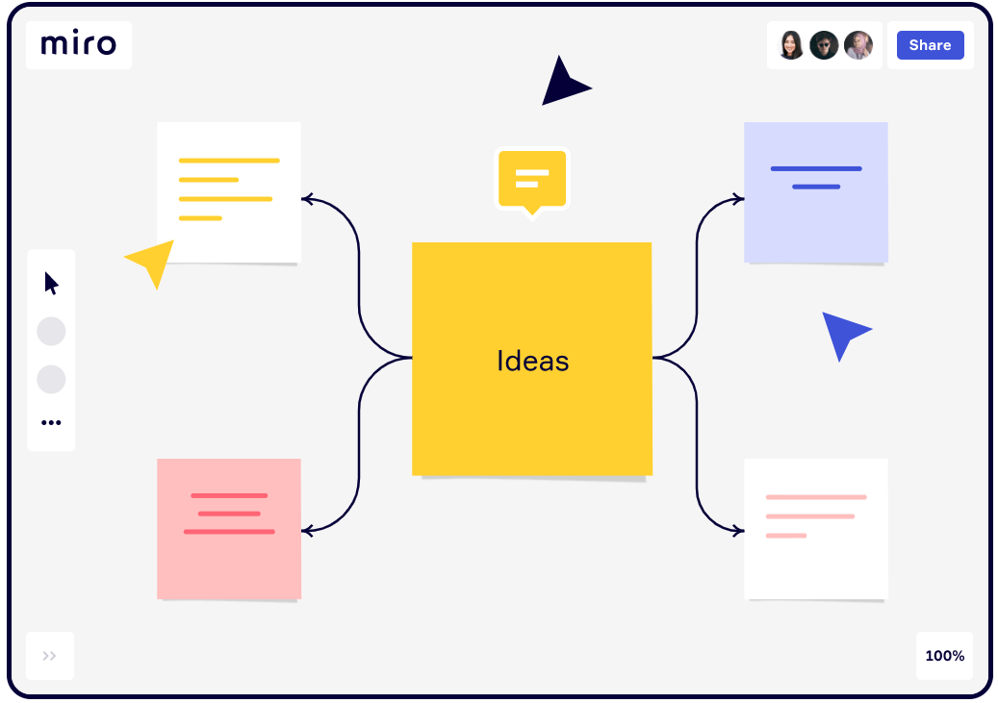
Miro board
Positions itself as a collaborative digital whiteboard that is simple to use. You can arrange objects, make notes, and connect via online chat or embedded videocalls all within the software.
(Innovation training (2021))

Slide 10
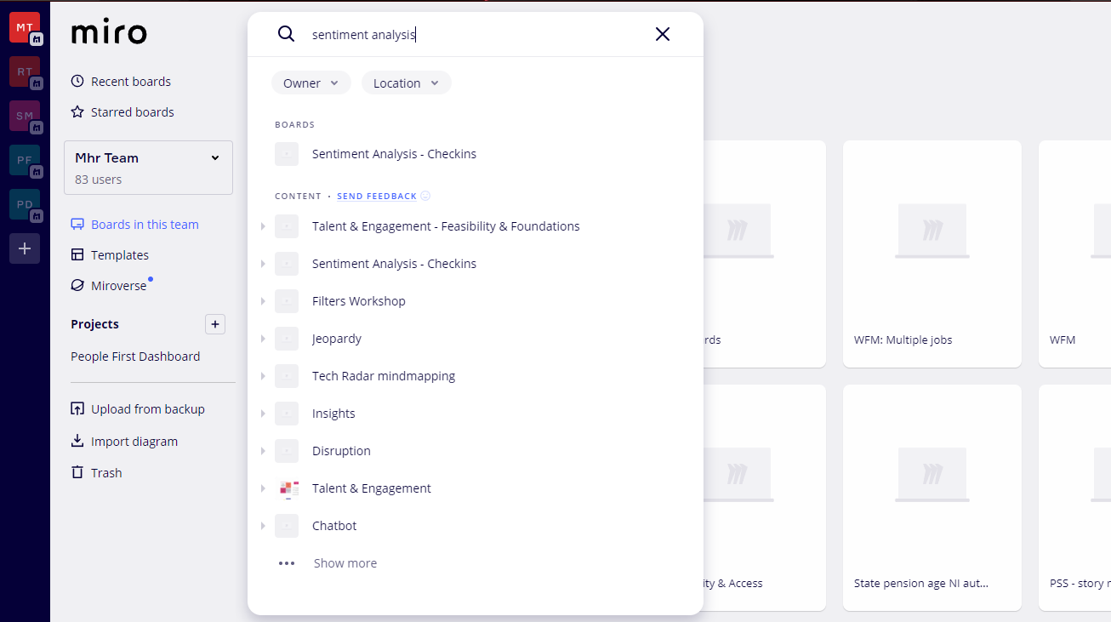
Miro board limitations
External tool – separate to MHR’s infrastructure
Very much a whiteboard online – so they can get unwieldy and hard to go back to
Search multiple boards is limited

Slide 11
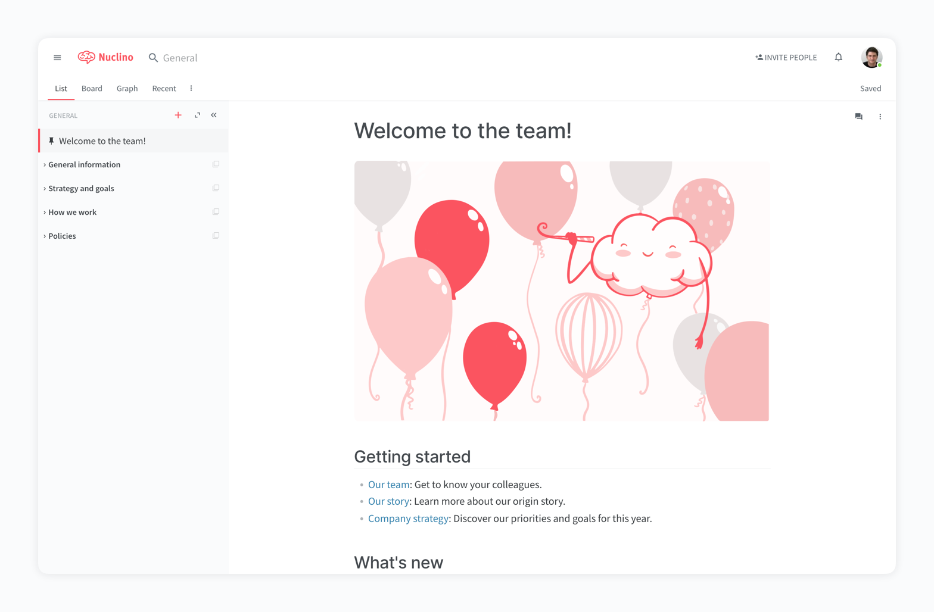
Nuclino
Teams may share and edit documents in real-time with the aid of the knowledge management and collaboration platform Nuclino. Furthermore, the effective search function rapidly displays pertinent results, and the phrases are highlighted in the results, making it simpler to locate desired information (Hero, 2021).
(Marketing tools you can use 2022 (2022))

Slide 12
Nuclino limitations
Completely new tool, separate to MHR’s infrastructure.
Content hosted outside of MHR datacentre.
High price for budget

Slide 13
Results of analysis
Keep the system within MHRs cohesive infrastructure
01
Flexible data structure and searching
02
Within MHRs datacentre
03
Content templating
04

Slide 14
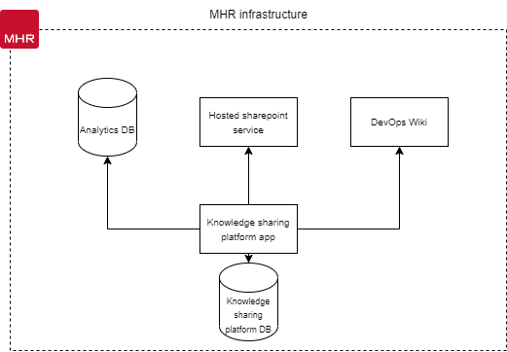
Proposal
This new system will be built inhouse, allowing for controlled outcomes of the solution’s requirements and features. This will also enable cohesive services for employees to use and provide a cloud application allowing employees to manage, tag, and search for content.

Slide 15
Knowledge is an individual mental process and information being its expression.
“
”
Yacine, Baouch & Pourroy, Franck & Zwolinski, Peggy & Brissaud, Daniel. (2014)

Slide 16
Challenges
People don’t share new knowledge: The repository needs to be added to regularly to ensure knowledge doesn’t stay in personal notes, OneDrive documents or within teams, therefore it needs to be accessible and easy to use.
People can’t find knowledge: The tool needs to have a good mechanism for searching so that discoverability of current knowledge is easy.
Knowledge needs to stay in-house: The tool needs to have secure access for MHR internal employees only (e.g. use of single sign on).
People will want the solution to fulfil other requirements: When creating the solution, ensure that it doesn’t try to fulfil too wide a scope – first and foremost it is an easy-to-use repository of knowledge for MHR.
Notes:
People don’t share new knowledge: The repository needs to be added to regularly to ensure knowledge doesn’t stay in personal notes, OneDrive documents or within teams, therefore it needs to be accessible and easy to use.
People can’t find knowledge: The tool needs to have a good mechanism for searching so that discoverability of current knowledge is easy.
Knowledge needs to stay in-house: The tool needs to have secure access for MHR internal employees only (e.g. use of single sign on).
People will want the solution to fulfil other requirements: When creating the solution, ensure that it doesn’t try to fulfil too wide a scope – first and foremost it is an easy-to-use repository of knowledge for MHR.

Slide 17

Project scope
Phase 1
Cloud-based central knowledge platform.
The central repository will allow users to manage, feedback and share content between employees of MHR.
Provide simplistic searching capabilities with content templating.

Slide 18
Project timeline
Development completed
Publish to userbase
Jan 2023
Analysis/Software Requirements
Feb 2023
Foundation scope 1
DevOps & Environment Development Setup
March 2023
Development -
Timebox 1 & 2 begins
April 2023
Development – Timebox 1 & 2 completed
May/June 2023
Timebox 3 begins

Slide 19
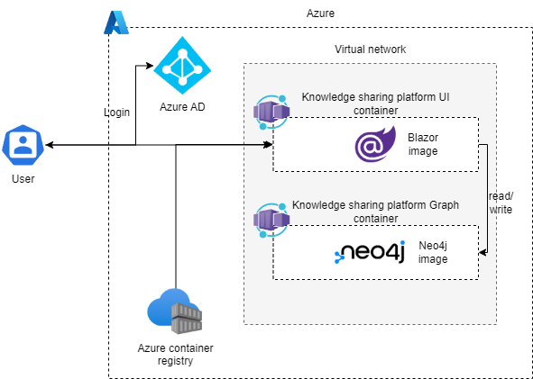
Architecture Diagram
Using Azure as the cloud provider.
Azure AD for SSO
Azure container registries for

Slide 20
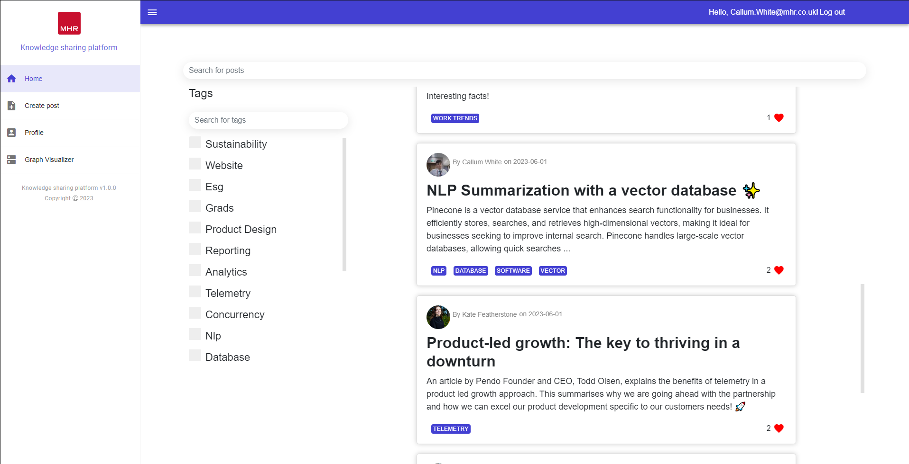
Landing page

Slide 21
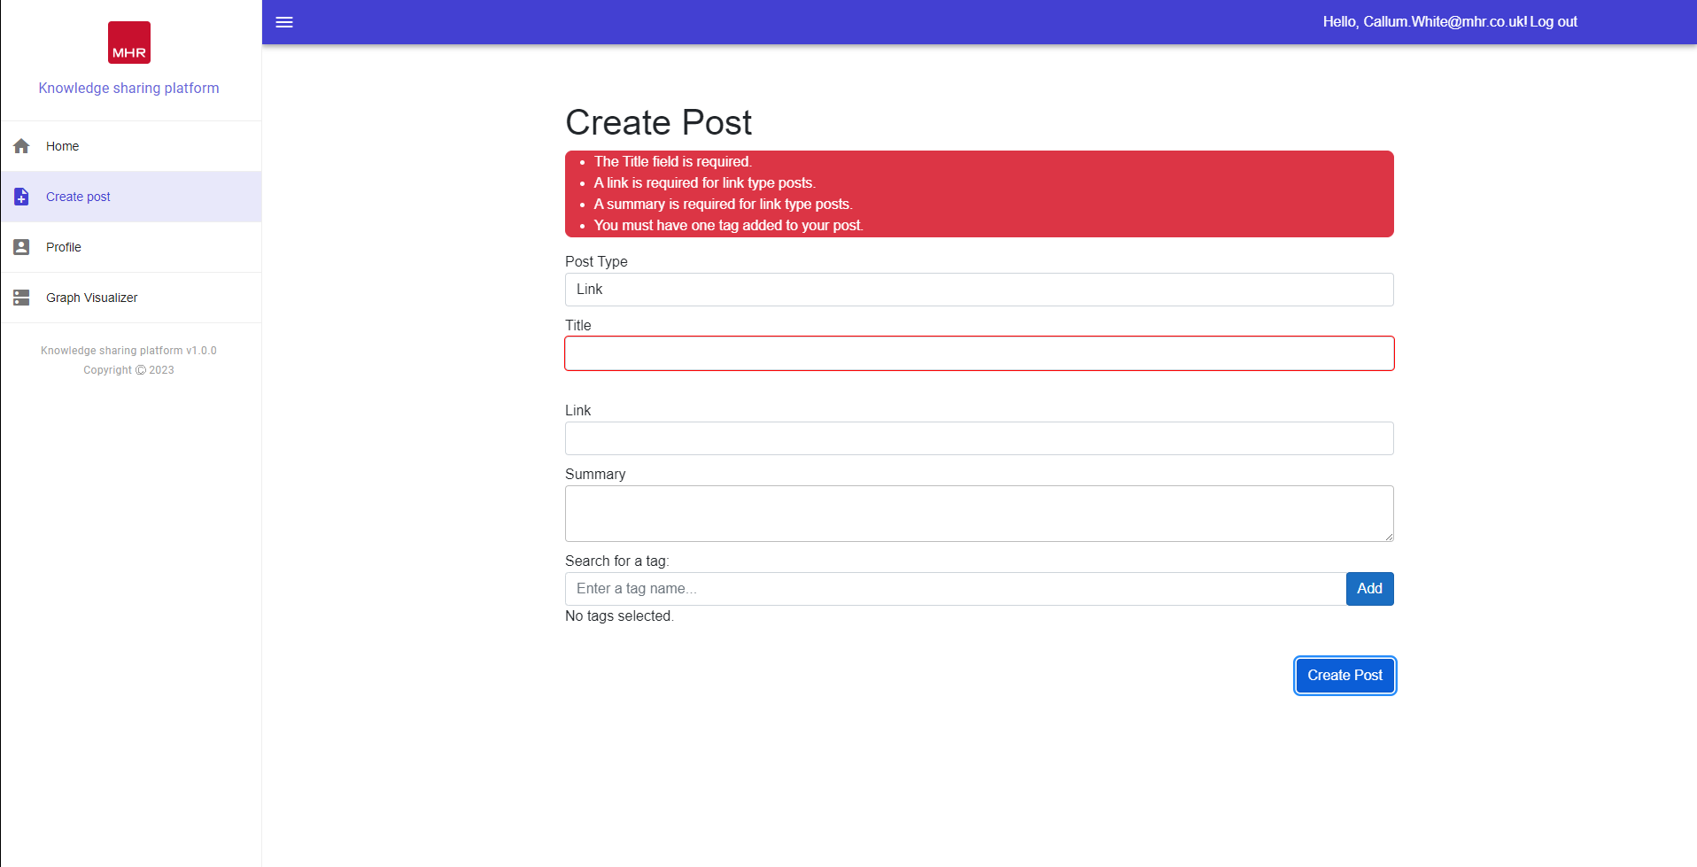
Create post

Slide 22
Thank you

Slide 23
Q&A

